Slide 1
Electric Flow DSL IDE
Hackathon Results
Aug 7, 2015
Ito, Vinoo, & Greg

Slide 2
Hackathon Goals
Improve the productivity of EF DSL authors
Lower the barriers to adoption

Slide 3
What is Electric Flow DSL
Domain Specific Language
An authoring language for Electric Flow
Scripting language (Groovy)

Slide 4
Why DSL?
Potential for high productivity (vs. UI and ec-perl)
Ability to work at scale
Maintainable, versionable process/orchestration as code
Idempotent for iterative and consistent behavior

Slide 5
ec-perl vs. DSL – “Hello World” procedure
use strict;
use ElectricCommander;
$| = 1;
my $ec = new ElectricCommander({'format'=>'json'});
$ec->createProject("Hello Project");
$ec->createProcedure("Hello Project",
"Hello Procedure");
$ec->createStep("Hello Project",
"Hello Procedure",
"Hello World from ec-perl");
project "Hello Project", {
procedure "Hello Procedure", {
step "Hello World",
command: "echo Hello World from EF DSL!"
}
}
ec-perl helloProcedure.pl
ectool --format json evalDsl –dslFile helloProcedure.groovy
Not so different? Make a small edit and run again…
DSL: No problem
ec-perl: helloProcedure error [DuplicateProjectName]: Project 'Hello Project' already exists

Slide 6
The reality of authoring in DSL
Requires high level of expertise
EF architecture
API Syntax
Complex API responses
Debugging challenges
Primary mode of access is command line
File based
Where is $[property] getting evaluated?

Slide 7
Demo

Slide 8
Demo
Procedure creation
Autocompletion
Template based coding
DSL and Groovy syntax colorization
Additional examples of Template based coding
Reference examples
Undo
Save and open files locally
getProjects
getProcedure
Formatting

Slide 9
EF DSL IDE Features
Web based Groovy and EF DSL aware editor (colorized)
File save and open DSL content
Run DSL against EF server
Auto complete with command templates
Help on command
Undo
Format
Examples
Embeddable into Electric Flow

Slide 10
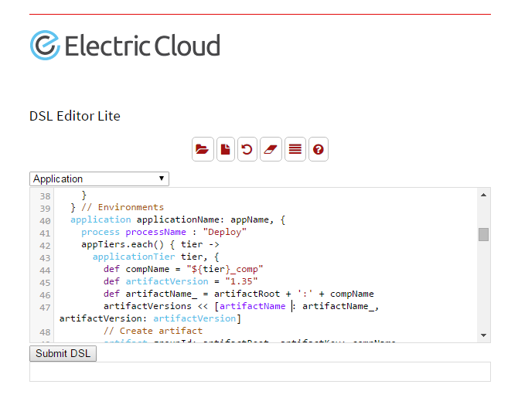
Electric Flow DSL IDE

